Slide 1

ROBOTICS(MEM720) PROJECT PRESENTATION
MUSTAFA USTA
200313004

Slide 2
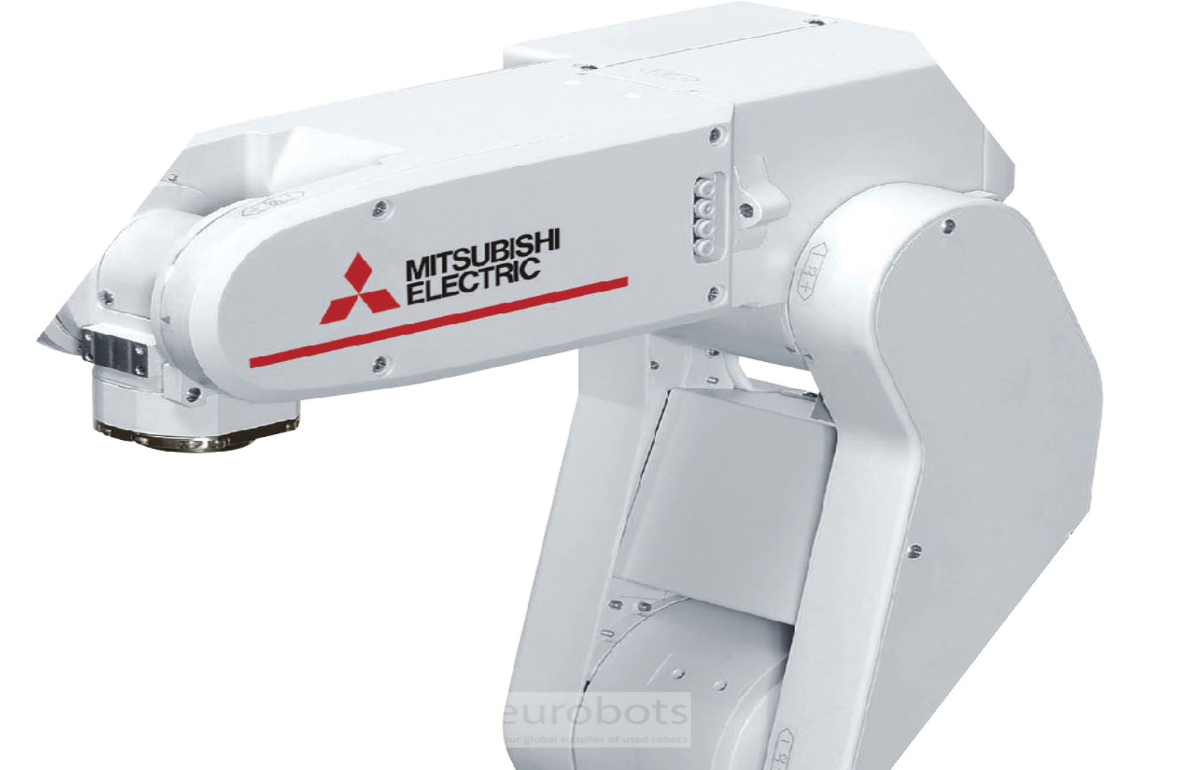
Automation systems are an important technology in modern industries aiming to increase productivity by reducing labor. In this project, an automation system is designed in which a conveyor belt system and a robot arm are integrated. The project is based on detecting and classifying products of different sizes and performing appropriate operations. The system is a mechatronic application where sensors, microcontrollers and robotic elements are used together.
The main objective of this project is to automatically detect the dimensions of the products being transported on the conveyor belt and to guide them with robotic operations within the framework of an appropriate scenario. Thus, it is aimed to minimize human intervention by automating product classification, quality control and handling processes in production lines.
Industrial Automation System

Slide 3
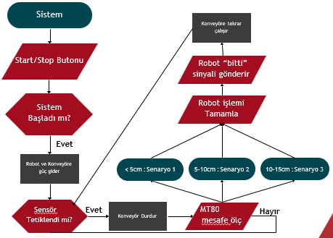
Divider
Operating Algorithm of System

Slide 4
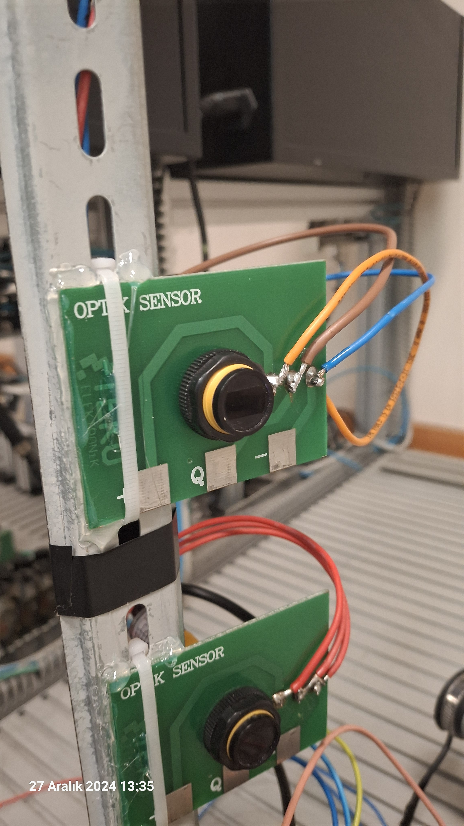
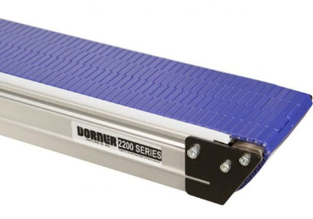
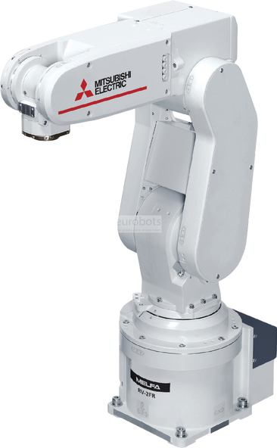
Materials Used
Mt 80 Optic Sensor
Conveyor Band System
Robotic Arm

Slide 5
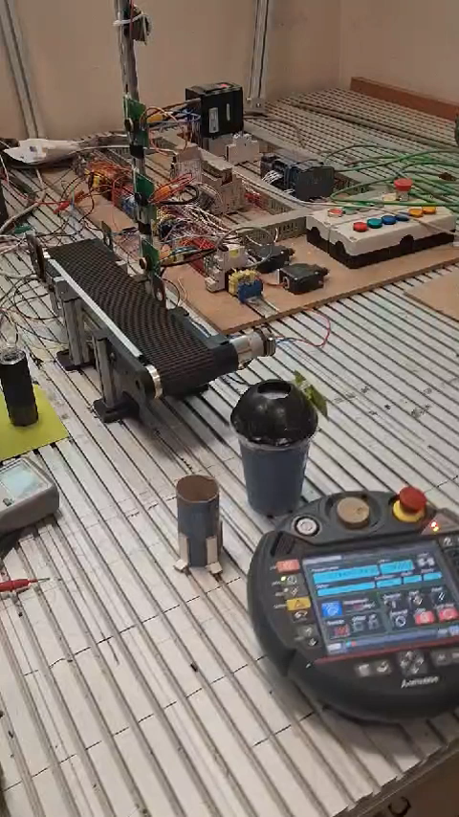
Operation Video of The System
The integrated assembly system features three different types of mountable components that are transported through the conveyor system in a complex, non-sequential order. The corresponding mounting station is positioned parallel to the conveyor line. Through an array of sophisticated sensors, the system performs real-time component identification and classification. Upon detection, the robotic system automatically executes the appropriate assembly sequence, matching each component with its corresponding mounting procedure. This automated workflow ensures precise and efficient assembly operations while maintaining consistent quality standards.

Slide 6
Thank you!
Mustafa USTA
Batuhan Ural
200313004
200313014

